Slide 1
Analog to Digital Conversion -ADC
Dr.Sreejith Rajan

Slide 2
ADC
  We have 10 bit ADC in ATMEGA 328 (10 bit resolution)
  ADC needs A_{vcc}, A_{ref} and Input Signal V_{is} to function.
  Reference Options : A_{vcc}, A_{ref} and internal 1.1V.
  Input Channels : AD0-AD7( Only 6 in DIL Package)
  ADC Clock must be between 50-200 kHz for best accuracy
1

Slide 3
ADC
  Digital Value = (V_{is} / A_{ref}) x 1024
  Eg : if V_{is}= 2v and A_{ref}= 5v
  Digital Value = (2/5) x1024
  = 409
  Input signal voltage = V_{is} = (Digital Value X A_{ref} )/1024;
1

Slide 4
Key Registers
  ADMUX – Multiplexer Selection Register
  ADCSRA – ADC Control and Status Register A
  ADCL and ADCH – ADC Data Registers
  ADCSRB – Control and Status B
1

Slide 5
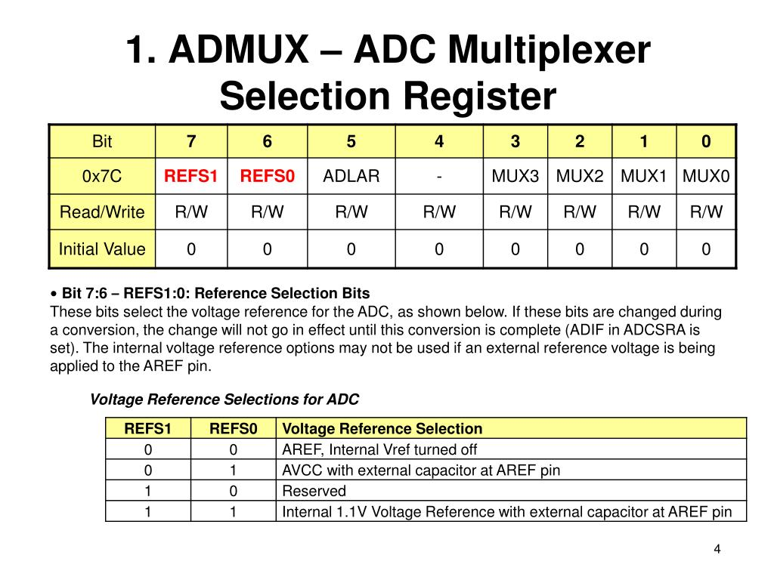
ADMUX
1

Slide 6
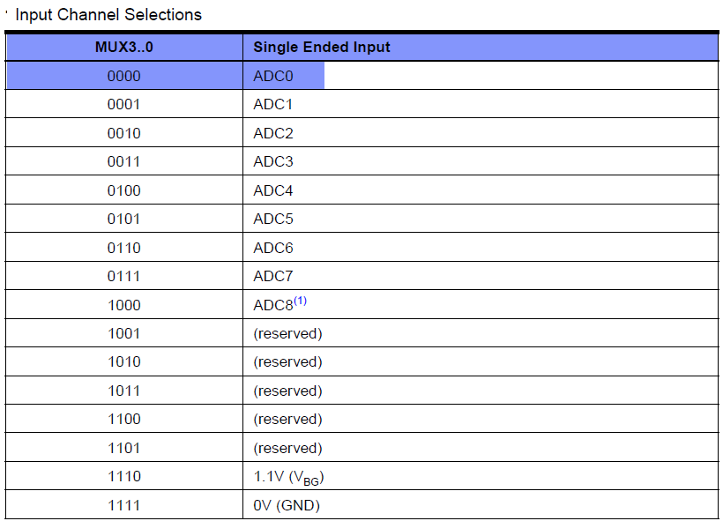
ADMUX
1

Slide 7
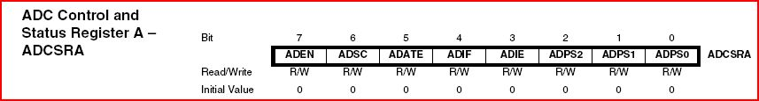
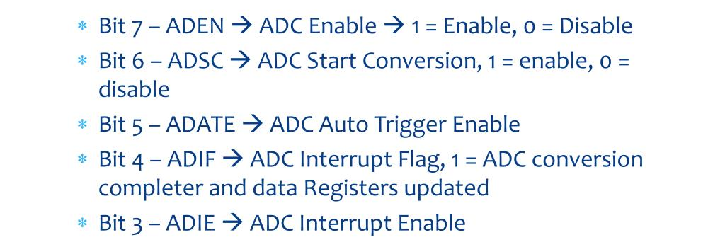
ADCSRA
1

Slide 8
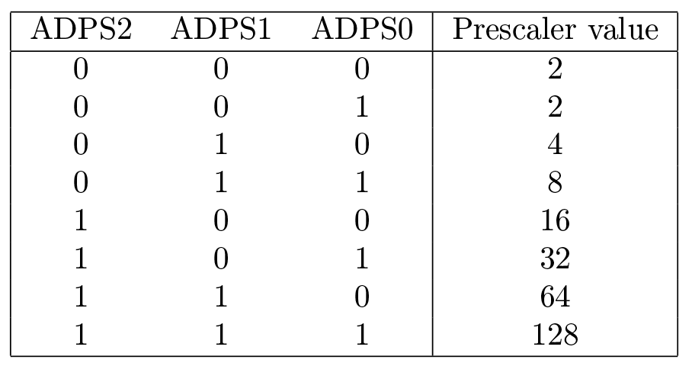
ADCSRA
1

Slide 9
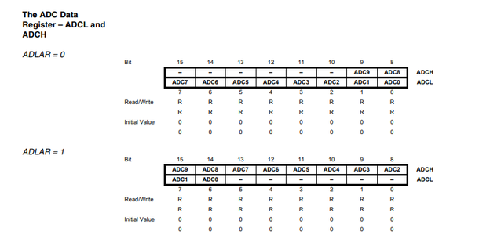
ADC Data Register – ADCH and ADCL
1

Slide 10
Algorithm
Step 1 : Select ADC Reference Voltage (ADMUX)
  Registers involved: ADMUX
  Bits: REFS1:REFS0
Step 2 : Select Result Adjustment
  Bit: ADLAR
  0 → Right-adjusted (default, full 10-bit)
  1 → Left-adjusted (8-bit quick read)
Step 3: Select ADC Channel
  Registers involved: ADMUX
  Bits: MUX4:0 → Selects ADC0–ADC7
Step 4: Enable ADC
  Registers involved: ADCSRA
  Bit: ADEN (ADC Enable)
Step5 : Set ADC Prescaler
  Registers involved: ADCSRA
  Bits: ADPS2:0

Slide 11
Algorithm
Step 6 : Start ADC Conversion
  Registers involved: ADCSRA
  Bit: ADSC (ADC Start Conversion)
Step 7: Wait for Conversion to Complete
  Registers involved: ADCSRA
  Bits: ADSC or ADIF
Step8 : Read ADC Result

Slide 12
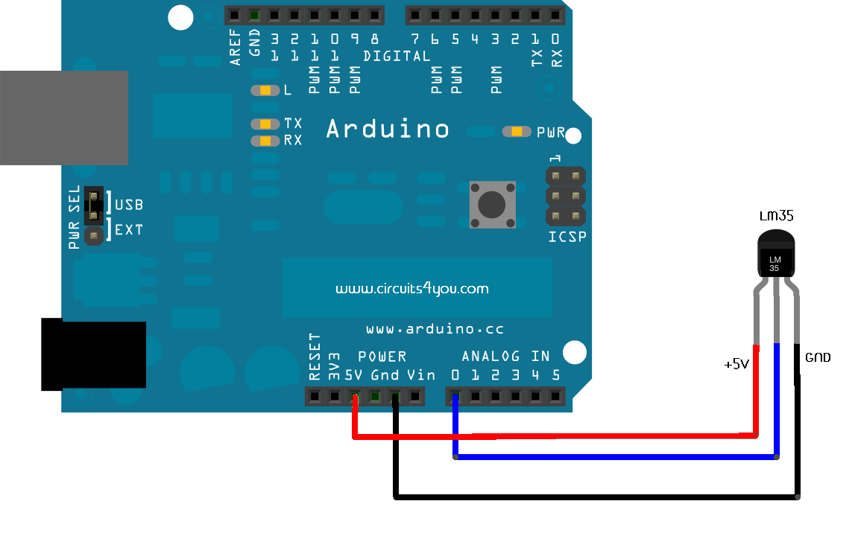
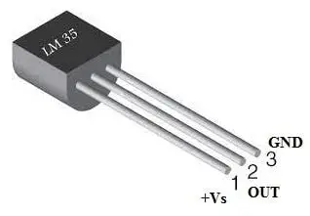
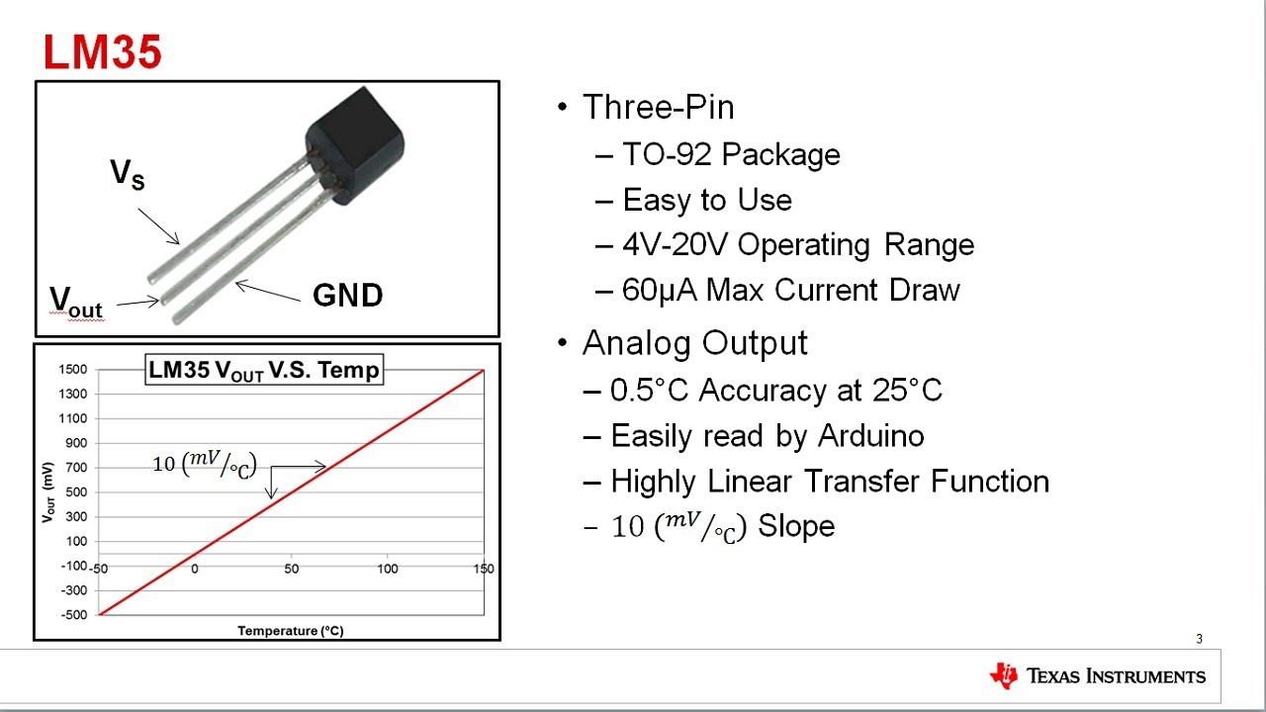
LM 35 Temperature sensor with Arduino

Slide 13
LM 35 Temperature sensor with Arduino

Slide 14
Read Temperature and Display
Use basic math to convert ADC Value to Temperature
Use lcd.h and lcd.c to print temperature in the LCD

Slide 15
THANK YOU

